Slide 1
Shared Mobility Opportunities
Erik Rudeen
Office of Government Affairs
August 2023

Slide 2
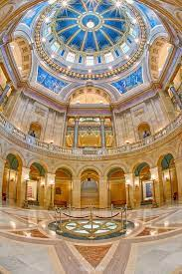
Historic 2023 Legislative Session
Matching funds for IIJA
$2M technical assistance for local gov’ts, tribes, MPOs (up to $30k)
$216.4M to match federal grants (up to $10M)
Climate change
$13.6M EV infrastructure, public-private partnerships
$600/$2500 EV credits
$4M electric bicycle grants
~$40M active transportation, ~$22.5M safe routes to school
Passenger rail: Chicago, NLX, St. Cloud/Fargo
Sustainable aviation fuels
Greenhouse gas and vehicle miles traveled assessment, mitigation

Slide 3
Transit Investments
0.75% Metro Sales Tax
83% to Met Council
5% for active transportation
17% to Counties
41.5% for active transportation and corridor safety studies
41.5% to repair/rehab existing facilities
17% for transit, complete streets, GHG/VMT mitigation
Greater Minnesota Transit
5.7% motor vehicle sales tax (up from 4%)
$40M for the biennium
$4M St. Cloud transit analysis
$5M Stone Arch bridge in Minneapolis
Grants to TMOs

Slide 4
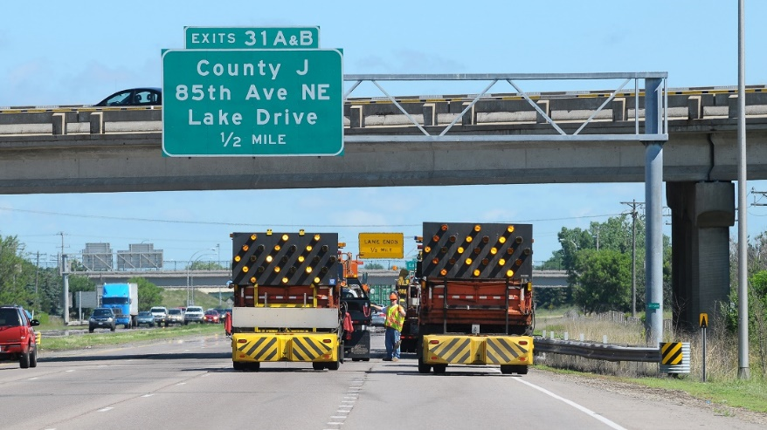
Capital Investment Bills
$85M Local road program
+ $146.5M earmarks
+ $18M in transportation bill
$67M Local bridge program
+ $42M earmarks
+ $18m in transportation bill
Project highlights
TH 65 – Anoka County: $34M
3rd Street Bridge – St. Paul: $25M
BRT – Met Council: $72M
Apple Valley Transit Station – Met Council: $7M
Numerous trails

Slide 5
Trunk Highway Bonding
$599M trunk highway bonding
$200M state road construction
$158M earmarks
TH 65 – Anoka County: $68.75M
US 10 – Anoka County: $30M
US 8 – Chisago County: $42M
TH 61 – Two Harbors: $11M
US 169 – Scott County: $4.2M
TH 3 – Rosemount: $2.2M

Slide 6
IIJA Grant Opportunities
Opening Date | Program | Closing Date
4/21/2023 | Promoting Resilient Operations for Transformative, Efficient, and Cost Saving Transportation (PROTECT) – Discretionary | 8/18/2023
6/27/2023 | Multimodal Project Discretionary Grant Opportunity (Mega, INFRA, and Rural) | 8/21/2023
7/5/2023 | Reconnecting Communities Program and Neighborhood Access and Equity Grant Program | 9/28/2023
July 2023 | Transit-Oriented Development Pilot Program
Summer 2023 | Thriving Communities
Summer 2023 | Bridge Investment Program
Summer 2023 | Railroad Crossing Elimination Program
August 2023 | Strengthening Mobility and Revolutionizing Transportation (SMART) Grants Program
Fall 2023 | Consolidated Rail Infrastructure & Safety Improvements Grant Program

Slide 7
Challenges
Workforce – hiring and retaining challenges, staying competitive in the market
Construction inspector workforce becoming less experienced
Some tech schools dropping programs for lack of instructors
Working with schools, counties and industry to fill instructor positions
Input on MnDOT plans and projects
Talk to your networks: we value input

Slide 8
Working Groups
Active Transportation Advisory Committee
Greenhouse Gas Emissions Impact Working Group (+ VMT)
Infrastructure Resilience Advisory Task Force
Clean Transportation Fuel Standard Working Group
Advisory Council on Traffic Safety
Environmental Standards Procurement Task Force
Rideshare Regulations Committee

Slide 9
Metro Transit
Transit Signal System Planning
Blue Line Light Rail Engagement Meetings
Met Council must use MnDOT staff assistance for:
(1) delivery method selection for light rail projects;
(2) risk assessment analysis in the planning, designing, and construction of light rail;
(3) contractor and subcontractor schedule analysis and contractual requirements;
(4) light rail cost management and budget analysis; and
(5) any other technical areas of expertise MnDOT may offer.

Slide 10
Thank you!
Erik Rudeen
Office of Government Affairs
erik.rudeen@state.mn.us

